Slide 1
Ovid:
The Power Searcher’s
First Choice
JBI & LWW Books for CHIP Members: 2014 Offer
February 24, 2014
Thomas McGeough
Regional Sales Manager
Notes:
..For both the(1) current client presentation and the 2) new to Ovid presentation consider changing:
Biomedical Search Platform > Biomedical Power Search Platform
The Professional’s First > The Librarian’s or the Super Searcher’s First
If Michelle has an MLS, add it to her name
If Diane or Ben have Master’s or PhD’s add it to your names

Slide 2
Who are we? Ovid 101
A global leader in providing electronic medical and health information solutions
In North America All medical schools, 97% of teaching hospitals, 90% of hospitals with 200+ beds, Health Systems and buying groups large and small use Ovid.
Ovid’s mission is to deliver information that helps our users make critical decisions every day to improve patient care, enhance ongoing research, and fuel new discoveries. Recognizes the importance of Libraries and the role they play in healthcare.
Ovid is used by information librarians, nurses, doctors, managers, researchers, clinicians, educators, and students
Headquartered in New York, NY, Ovid has offices worldwide to support customers in over 90 countries

Slide 3
Agenda
Joanna Briggs Institute EBP Resources(JBI)
Ovid/LWW Book Purchase Offer for 2014
Odds & Ends

Slide 4
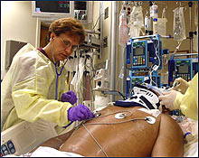
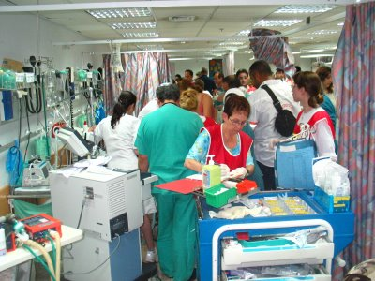
Global healthcare challenges today
The biggest challenge faced by healthcare institutions today is providing
evidence-based, cost-effective,
quality care that will improve practice
and improve patient outcomes and increase reimbursement levels
Only 20% of what healthcare providers do is based on evidence – 80% is not
Only 55% of time patients get the evidence-based recommended course of treatment
It takes 15 years to get evidence into practice

Slide 5

Integrating evidence into practice
to improve patient outcomes!

Slide 6



Joanna Briggs Institute
Mission – To create Content and Tools to support the implementation of evidence-based practice in patient care worldwide.
Notes:
JBI (Joanna Briggs Institute) is an international, non-for-profit membership based, research and development organization based within the Faculty of Health Sciences at the University of Adelaide in South Australia. The institute collaborates with 70 entities across the world. It was founded in 1996 and is the global leader in evidence-based healthcare with its unique content and approach, getting research into practice.
Joanna Briggs... (1805-1880) was a 19th century nurse and wife to Henry Briggs, the first pharmacist at the Royal Adelaide Hospital in Australia. 1855 Joanna Briggs was appointed the first Matron (Head Nurse) of the RAH. She started with a staff o 3 nurses and built the team to 21 by her retirement at 1866. She was the most prominent nurse in Australia in her lifetime.
JBI regards evidence-based health care as a cyclical process.
Vision: the improvement of the health status of the global population through the delivery of health care that is based on the best available evidence.
Mission: to facilitate evidence-based health care practice globally. Utilization of evidence of the feasibility, appropriateness, meaningfulness and effectiveness of health care practices. PUTTING evidence into practice.

Slide 7
Research and development organization
Collaborates Internationally
70 entities World-Wide
Promote and support evidence
Improve Healthcare outcomes Globally
University of Adelaide in South Australia

Slide 8
How JBI Can Help?
Provide Content and tools that will help your institution implement evidence–based practice
Systematic reviews, Recommended Practices, Evidence Summaries, Best Practices, and more
Evidence to inform clinical practice — derived from JBI's Global Collaborating Centers in over 40 countries
Summarized research in a format that is easy to locate, understand and distribute.
Tools designed to help EBP policy and practice manual development based on evidence
Critical appraisal skill development using a tool to guide you through the steps
Resources designed to help assess quality of research

Slide 9
JBI EBP Resources
Improve Health
Search: Find the research/ evidence
Appraise the evidence
Implement the evidence
Evaluate practice changes and patient outcomes
Find the Evidence
Best Practice Information Sheets
Recommended Practices
JBI Manual Builder
JBI Consumer Pamphlet Builder
JBI CAN-Implement
JBI Rapid
JBI Journal Club
JBI SUMARI
JBI TAP
Evaluate Practice
Appraise the Evidence
Systematic Reviews
Evidence Summaries
Systematic Review Protocols
Technical Reports
JBI PACES
JBI POOL/COOL
Implement the Evidence

Slide 10
14 Subject Area Nodes
Aged Care
Burns Care
Cancer Care
Chronic Disease
Diagnostic Imaging
Emergeny and Trauma
General Medicine
Health Services Management (Policies)
Infection Control
Mental Health
Midwifery Care
Rehabilitation
Surgical Services (peri-operative)
Wound Healing and Management
Notes:
Each node of JBI is supported by an Expert Reference Group and a Corresponding Reference Group (external experts)
Nodes may be used as a part of a search strategy or used as limits to focus the search results
Additional nodes are planned for 2013. Can be seen in the result, citation view
Node contents are designed to meet the needs of Service providers, Health professionals, GPs, MDs, RNs, Ens, case workers

Slide 11
7 Publication Types
Evidence-Based Recommended Practices
Evidence Summaries
Best Practice Information Sheets
Systematic Reviews
Consumer Information Sheets
Technical Reports
Systematic Protocols

Slide 13

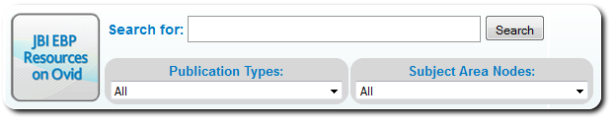
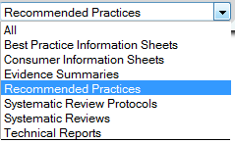
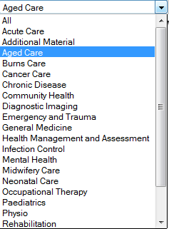
JBI
palliative care

Slide 15
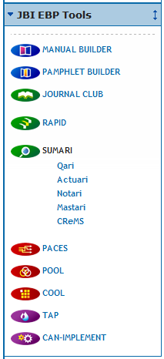
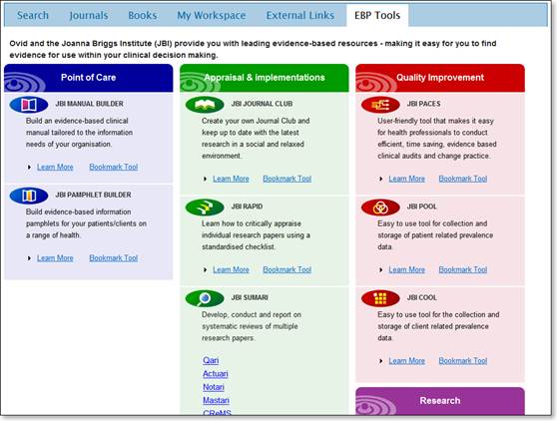
Getting to the Tools
Tools live on JBI site
Users will need to authenticate with Personal Account

Slide 16
JBI’s Evidence-based Practice Methodology
Develop the research question
Search: Find the research/ evidence
Improve Health
Evaluate practice changes and patient outcomes
Appraise the evidence
Implement the evidence

Slide 17
JBI Tools
  Manual Builder - Assemble procedures manual using JBI EB resources
  Consumer Pamphlet Builder - Assemble patient information using JBI EB resources
  CAN-IMPLEMENT - Evidence implementation for the care manager

Slide 18
JBI Tools
  RAPid (Rapid Appraisal Protocol Internet Database) - Critical appraisal of evidence for the researcher. If they they need process tools, need teaching tools for evaluating quality of an article -
  JBI Journal Club - Develop critical appraisal skills
  SUMARI (System for the Unified Management of the Assessment and Review of Information) - Systematic Review research and compilation for the researcher
  TAP (Thematic Analysis Program) - Qualitative evidence analysis for the researcher

Slide 19
JBI Tools
  PACES (Practical Application of Clinical Evidence System) - On-line program to assist with clinical audit and practice change
  COOL (Client Outcomes On Line) - On-line program to assist in gathering information about client outcomes (aged care specific)
  POOL (Patient Outcomes On Line) - On-line program to assist in gathering information about patient outcomes –

Slide 20
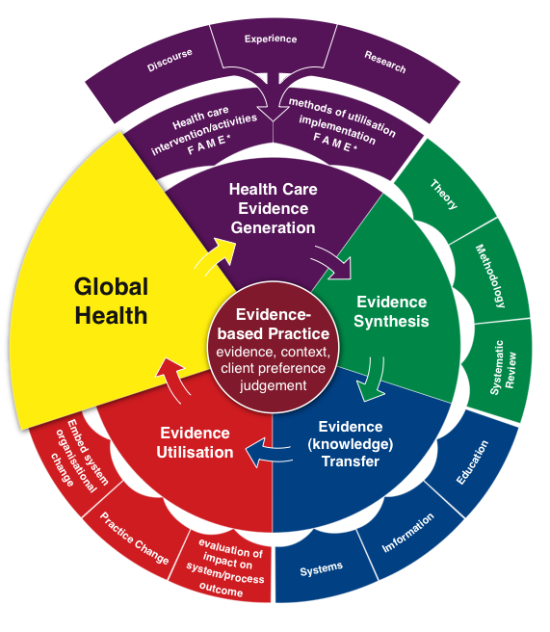
JBI Evidence-Based Practice Methodology

Slide 21
LWW Books for 2014
  Choose from over 1000 LWW Books
  Around 300 just from 2012-2014.
  130 from 2013-204
  40 from 2014
  100% Customizable Collection. Choose only the titles you want
  One-Time Purchase. You buy it, you own it.
  Unlimited Usage
  Many titles Doodys Rated
  No group cooperation necessary
  Volume Discounts up to 40% off!

Slide 22





Premier Nursing Book Content on Ovid
American Nurses Association
  Largest, most influential nursing professional organization in US
  40 premium, professional reference covering:
    The Magnet® journey
    Nursing informatics
    Quality nursing care
    Healthcare ethics
    Professional development
LWW Book Recommendations:
  Lippincott Manual of Nursing Practice
  Lippincott's Nursing Procedures
  Lippincott's Nursing Drug Guide 2012
  Cardiac Nursing
  5-Minute Clinical Series
  And more…
Lippincott/JBI Synthesis Science in Healthcare Online Book Series
  Book 1: Translation Science and The JBI Model of Evidence-Based Healthcare
  Book 2: Synthesizing Qualitative Evidence
  Book 3: Synthesizing Evidence from Narrative, Text and Opinion
  Book 4: Synthesizing Quantitative Evidence
  Book 5: Synthesizing Evidence of Risk
  Book 6: Synthesizing Evidence of Diagnostic Accuracy
  Book 7: Synthesizing Economic Evidence

Slide 23


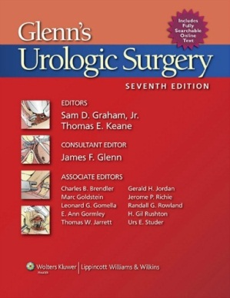
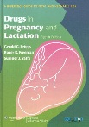
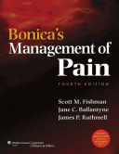
More clinical books from LWW…
Bonica’s Management of Pain
Devita’s Principles and Practice of Oncology
Drugs in Pregnancy and Lactation
Diseases of the Kidney and Urinary Tract
Diseases of the Beast
Schiff's Diseases of the Liver
Fields Urology
Joslin’s Diabetes

Slide 24
Homework and Next Steps.
For Me...
Email all book documentation such as LWW title lists and pricing and discounting info and rules.
JBI follow up info including pricing.
JBI Individual/Group call (Tues March 19, 11-11:45am) and/or demo?
Training for current JBI customers
For You…
Review Book list and place orders before the end of the year.
Schedule demo or trial for JBI. Choose package that is right for you.

Slide 25
