Slide 1

CHIP Meeting
July 29, 2015
Notes:
It’s 3 in the a.m. and you’ve got a patient that’s just been admitted via the ED. You don’t want to page your attending but you need some advice on what an experienced physician would do.
UTD has always been good at this. You might argue that’s why medical students love it so much and that familiarity just carries over into their residency and practice.
SEGUE: Now DynaMed does this too

Slide 2
INTRODUCING
Notes:
My name is Christian Patrick with EBSCO Health. Today I’m excited to announce the launch of DynaMed Plus. We’ve spent the last two years working on this product. I’m going spend about an hour talking about it leaving time for questions at the end.
SEGUE: DynaMed is a great product that continues to gain market share. So what are we trying to do with this product?

Slide 3
to DynaMed vs. UpToDate
TOP FIVE OBJECTIONS
It doesn’t tell me what to do
Lack of expert reviewers
Lack of specialty content
There are no images
It’s hard to get an answer quickly
Notes:
We’ve heard from you. We’ve heard from physicians. We understand that there were some real differences between DM and UTD.
DynaMed is NOT going away. We’re offering an alternative to competes directly with the features in UTD.
More than just becoming equal with UTD, we need to create a reason for people to change. We’ve done that.
SEGUE: Let’s take a look at each of these new areas in DM.

Slide 4

It doesn’t tell me what to do
Notes:
It’s 3 in the a.m. and you’ve got a patient that’s just been admitted via the ED. You don’t want to page your attending but you need some advice on what an experienced physician would do.
UTD has always been good at this. You might argue that’s why medical students love it so much and that familiarity just carries over into their residency and practice.
SEGUE: Now DynaMed does this too

Slide 5

OVERVIEWS AND RECOMMENDATIONS
Overviews and Recommendations provide clinicians with concise, accurate overviews for highly relevant topics and evidence-based recommendations for action.
Topics have been re-written from scratch to provide immediate context and direction
Notes:
Now DynaMed Plus offers overviews and recommendations. They are written in a directive style and have three areas of coverage: background, evaluation, and treatment.
Experts guided by the evidence
SEGUE: Let’s take a look

Slide 6
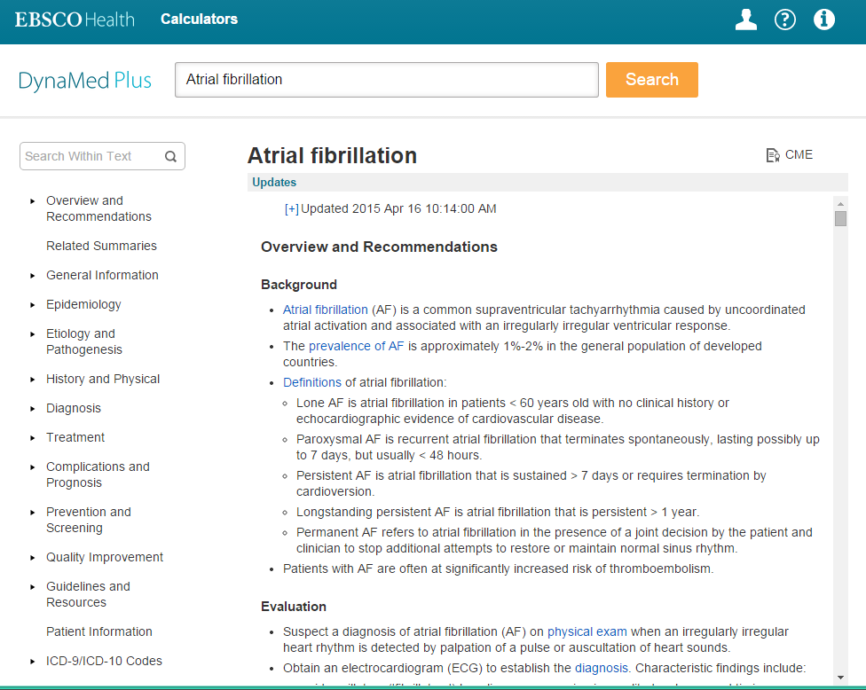
New Overviews and Recommendations at the top
Notes:
We’ve added the Overview and Recommendations at the top of the topic. However, we still have the same structure as in original DynaMed under the Overview. You’re not losing the rigorous evidence basis that has become the defining hallmark of DynaMed. It’s still there. We’ve just added to it.
SEGUE: Remember, this is still DynaMed so we’re also labeling the evidence

Slide 7
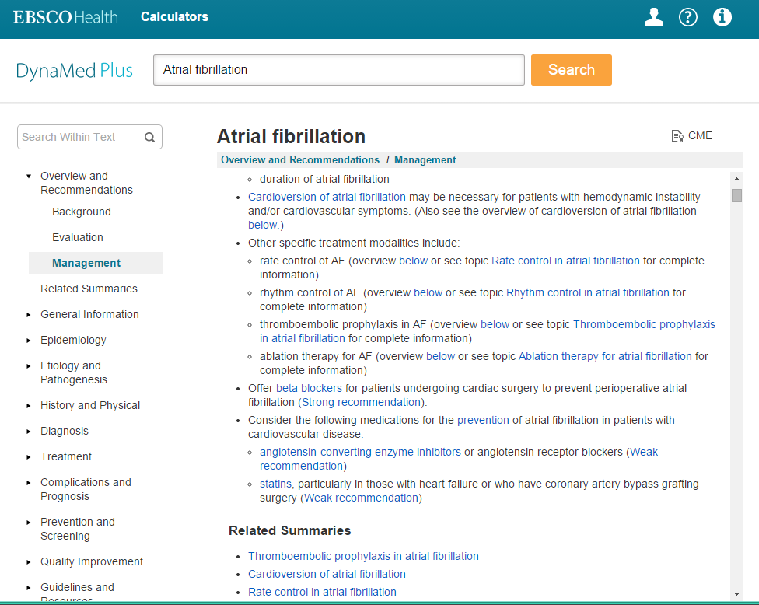
DynaMed Plus offers many examples of strong and weak recommendations
Clicking on a link provides the user with levels of evidence and guidelines behind each recommendation
Notes:
We’re identifying when the recommendation is strong or weak based on the evidence.
SEGUE: The hyperlink from the recommendation goes to the basis of the recommendation whether it’s a guideline or study.

Slide 8
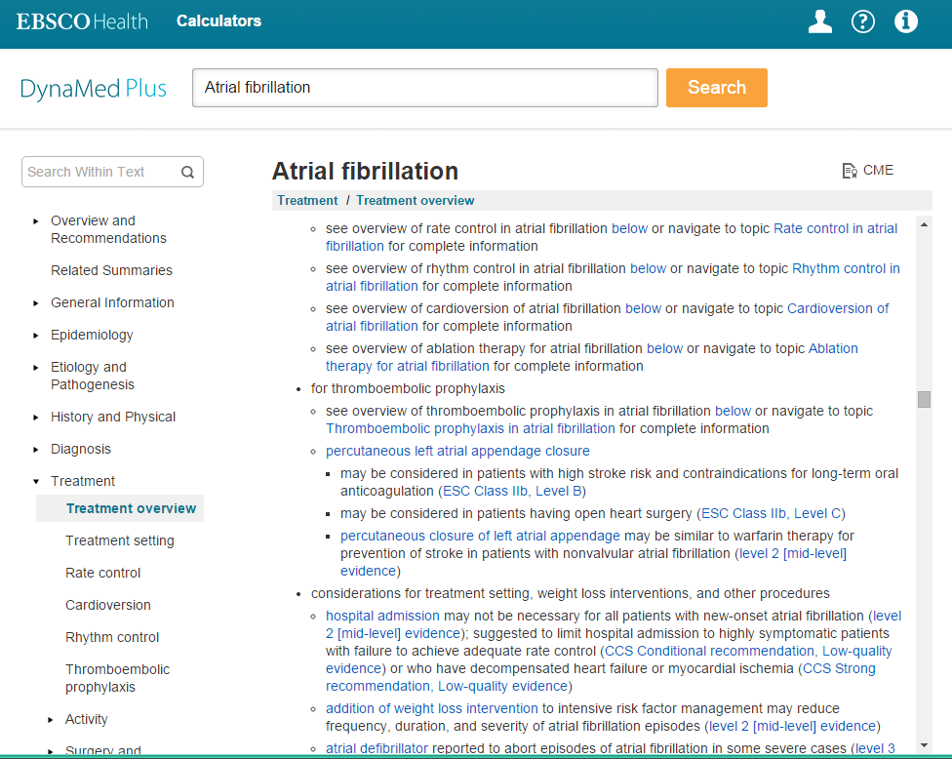
DynaMed Plus provides links to the levels of evidence and the guidelines behind each recommendation
Notes:
In this way, you’re getting the best of a recommendation ‘do this’ with the evidence to back it up in one click.
SEGUE: Further, we’ve adopted the standard for our recommendations, GRADE

Slide 9

The GRADE (Grading of Recommendations Assessment, Development and Evaluation) system was created in 2000
by a dedicated group of guideline developers.
What is GRADE?
RECOMMENDATIONS
are graded as Strong or Weak
EVIDENCE
is graded for the body of evidence as High, Moderate, Low or Very low quality (A, B, C, or D).
QUALITY
grading for evidence is based on the risk of bias introduced by study methodology, the precision the consistency of studies, the directness to the conclusion being made, and the likelihood of publication bias.
Notes:
GRADE is a way to measure the quality of the evidence behind a recommendation or guideline.
SEGUE: And it’s used by most guidelines organizations around the world

Slide 10
GRADE is now the standard
GUIDELINE GROUPS
More than 80 of the worlds leading organizations which
produce guidelines formally use GRADE:
SYSTEMATIC REVIEWS
Independent systematic review organizations such as Cochrane have incorporated GRADE.
WHO
The Endocrine Society
ACCP
ACP
American Thoracic Society
NKF/KDOQI
KDIGO
Norwegian Knowledge Center / Norwegian Directorate of Health
Canadian Cardiovascular Society
IDSA
CDC
AGA
AASLD
ICSI
NICE
SIGN
NHS
Kaiser Permanente
Dutch College of GPs
Multiple Red Cross groups
Notes:
Everyone is using GRADE.
SEGUE: Now let’s take a look at another perceived limitation of DynaMed.

Slide 11
Lack of expert reviewers
Notes:
DynaMed was started by a family physician, Dr. Brian Alper. Many of you have met him. While EBSCO expanded the number of physicians and their specialties for DynaMed, the market perception was that it was still a family medicine product.
SEGUE: We’ve put that behind us.

Slide 12

FULLY INTEGRATED EXPERTS
An extensive network of clinical experts work in partnership with DynaMed Plus Deputy Editors to select the best and most appropriate evidence, confirm the clinical applicability of content, and peer-review topics
Notes:
We’ve spent the last two years recruiting clinical experts to work with our editorial team and editorial methodology.
SEGUE: We’ve also expanded the number of experts dedicated to DynaMed Plus.

Slide 13
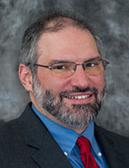
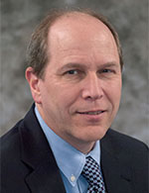
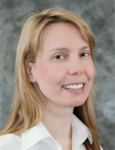
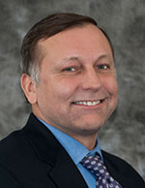
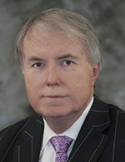
LEADERSHIP
BRIAN S. ALPER, MD,
MSPH, FAAFP
Founder of DynaMed, VP of EBM Research & Development, Policy and Content Quality, EBSCO Information Services, Clinical Research Assistant Professor
Department of Family and Community Medicine, University of Missouri School of Medicine
Columbia, MO
Editorial
ALAN EHRLICH, MD
Executive Deputy Editor
Assistant Clinical Professor in Family Medicine, University of Massachusetts Medical School
Worcester, MA
SHEILA BOND, MD
Deputy Editor of Infectious
Disease, Clinical Instructor in Medicine
Harvard Medical School
Boston, MA
PETER OETTGEN, MD, FACC
Deputy Editor of Cardiology
Director of Preventative Cardiology, Beth Israel Deaconess Medical Center, Associate Professor
Harvard Medical School
Boston, MA
KEVIN LOUGHLIN, MD, MBA, MA(HON)
Deputy Editor of Oncology and Hematology, Senior Surgeon
Brigham & Women's Hospital
Professor of Surgery, Harvard Medical School, Boston, MA
Notes:
This is just part of the physician team working at EBSCO’s headquarters on DM+. We now have 9 physicians in Ipswich working on DM+.
SEGUE: We’ve created a world-class executive board

Slide 14
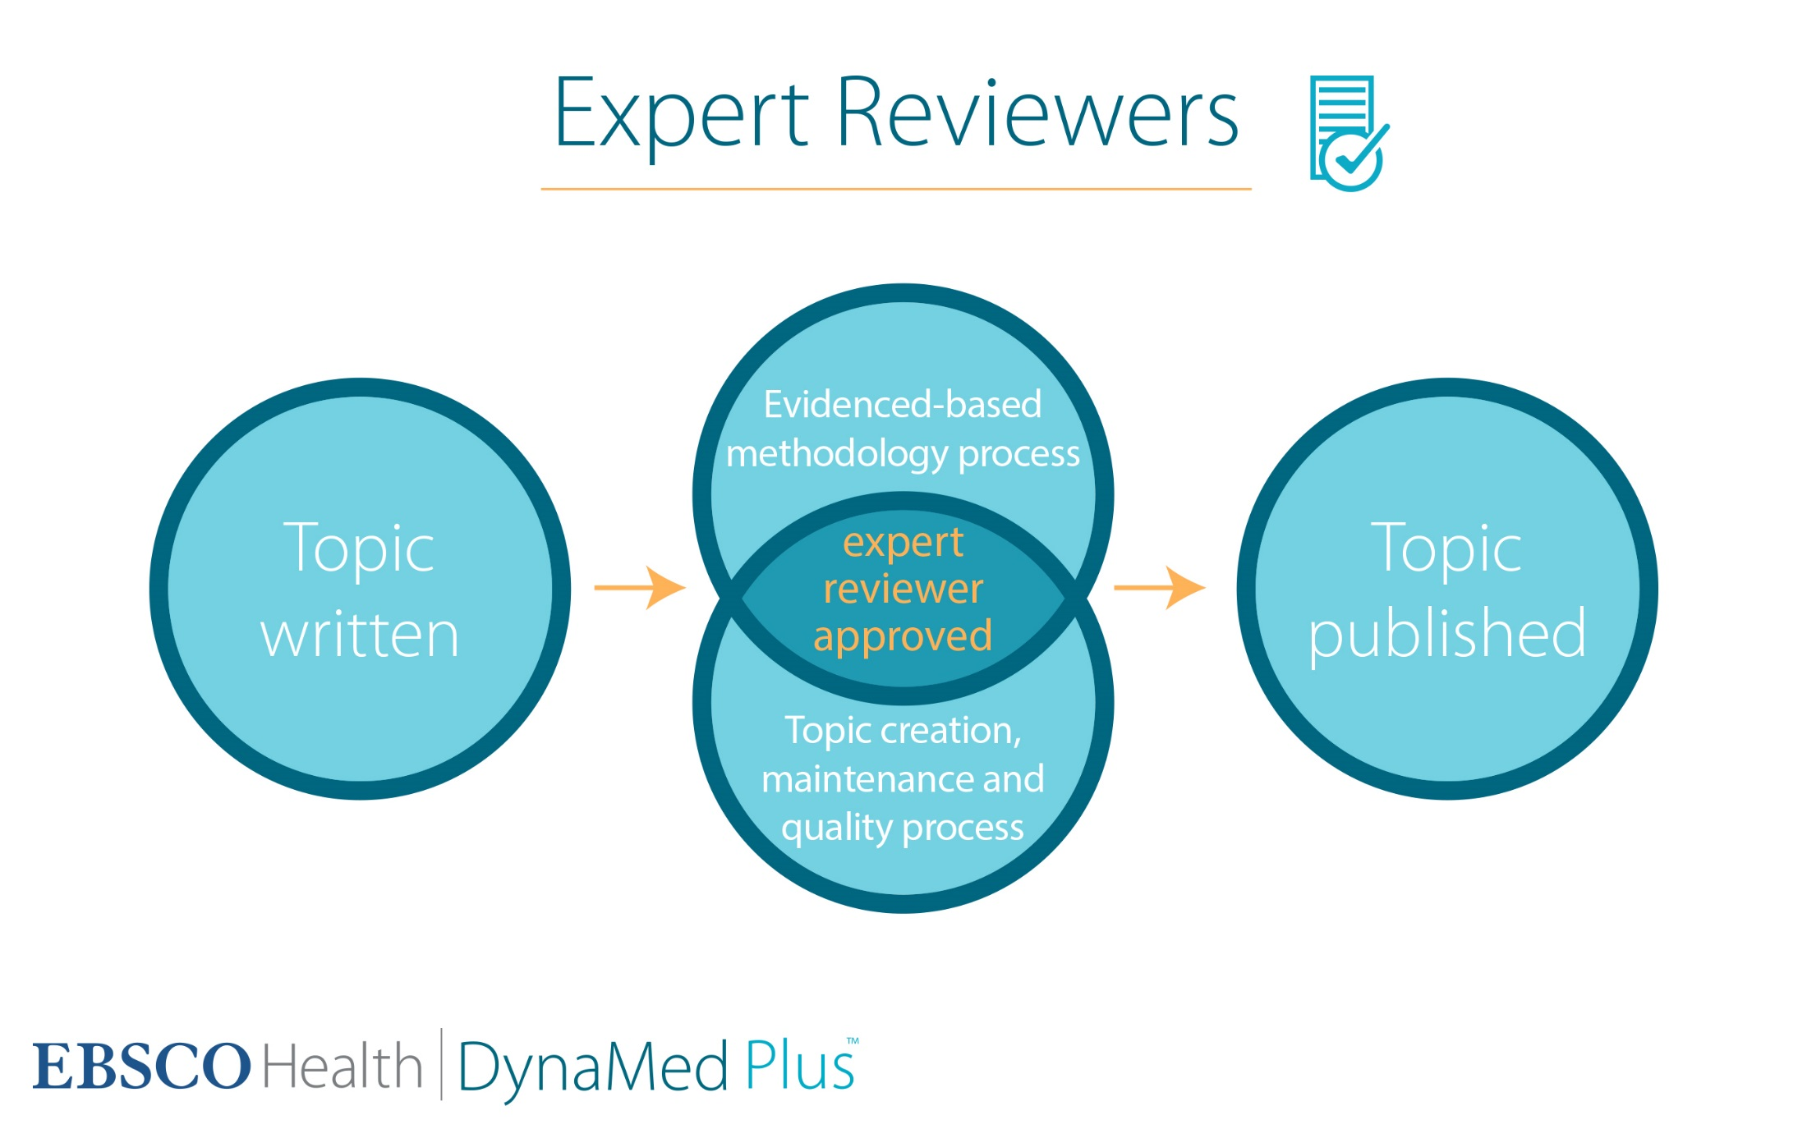
Notes:
It’s the best of both worlds – it’s experts informed by the evidence
SEGUE: We have invested in our physician leadership team

Slide 15
Executive Board
We have established a
12 MEMBER EXECUTIVE BOARD
charged with advising on editorial, EBM, policy, guideline and business challenges.
Members represent JAMA, McMaster, Penn, Emory, MGH, ACP and other
well-known healthcare organizations.
Notes:
The board will help guide on editorial matters, evidence-based practice, and guidelines.
SEGUE: Directly related to the complaint about experts is the perceived lack of specialty content.

Slide 16
Lack of specialty content
Notes:
SEGUE: In addition to adding to the editorial team…

Slide 17
Editorial team reorganized
The DynaMed Editorial team has been re-organized into five specialty publishing groups, experts recruited from Harvard, MGH, Beth Israel Deaconess, Yale, The Brigham, Dana Farber, UCSF and the Cleveland Clinic to name a few:
General Internal Medicine
Cardiology/Pulmonology/Critical Care
ID/Immunology
Oncology/Hematology
Emergency Medicine
Notes:
The Editorial team has been reorganized to support specialties. And specialty experts have been recruited to represent their subspecialties working under these new five publishing groups.
SEGUE: This allows us to develop…

Slide 18

ROBUST SPECIALTY CONTENT
Allergy
Cardiology
Critical Care
Dermatology
Emergency Medicine
Endocrinology
Gastroenterology
Hematology
Nephrology
Obstetrics and Gynecology
Oncology
Orthopedics
Pediatrics
Primary Care
Psychiatry
Rheumatology
Sports Medicine
Surgery
Urology
Notes:
Using the same 7-step methodology as DynaMed and with the same daily updating. It’s really the best of DynaMed and UTD.
Experts guided by the evidence.
SEGUE: Another comment that we hear is that we don’t have images in DM

Slide 19
There are no images

Slide 20
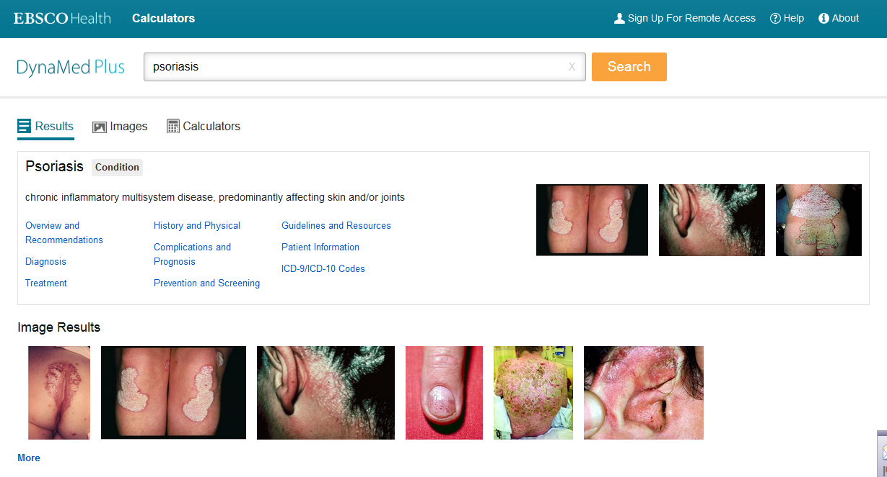
Notes:
DynaMed Plus includes more than 4,000 images with more than 2,000 from the American College of Physicians. Images are searchable as well as embedded in relevant topics

Slide 21
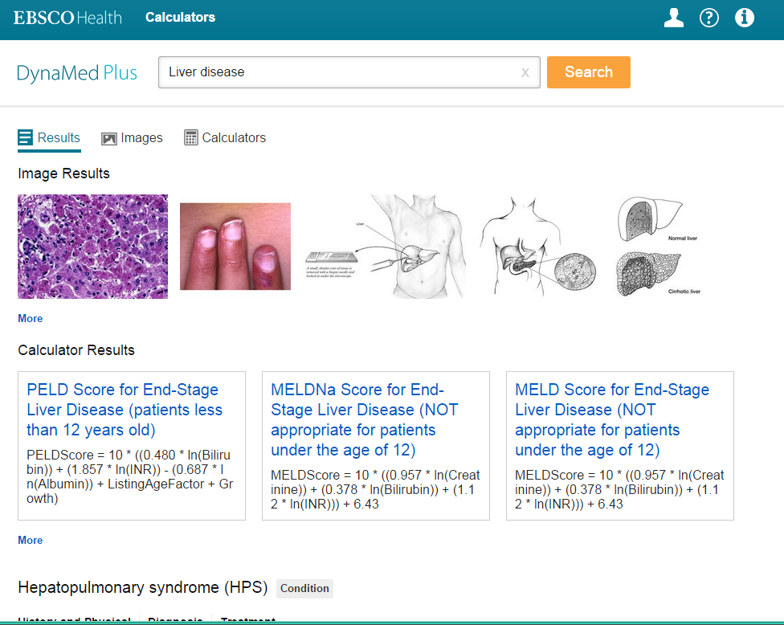
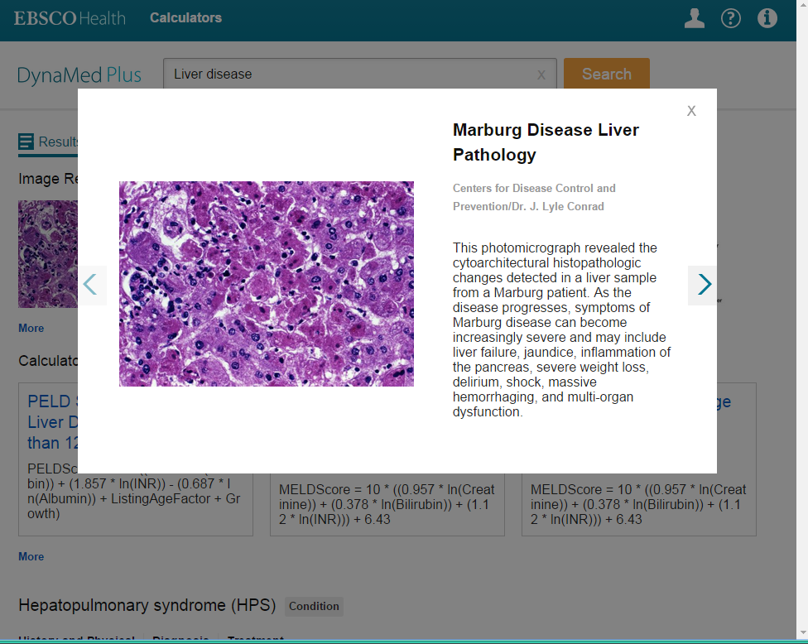

DynaMed Plus includes more than 4,000 images with more than 2000 from ACP. Images are searchable as well as embedded in relevant topics
Selecting an image provides the user a larger view
Notes:
The images are downloadable with a simple mouse click and useable for non-commercial purposes. And you don’t have to save them in ppt to use them somewhere else!
SEGUE: So far I’ve talked about the areas where we’ve matched UTD and in some ways moved ahead of them. Now I’d like to talk to you about where we’re taking a giant leap forward.

Slide 22
It’s hard to get an answer quickly
Notes:
We’ve done a lot of research recently about how physicians gather information. Two things became very clear. They’re on their mobile devices. And they are going to Google.
These observations inform everything that we’ve done with DM Plus. We’ve created a next generation POC search that gives physicians a reason to switch from UTD.

Slide 23
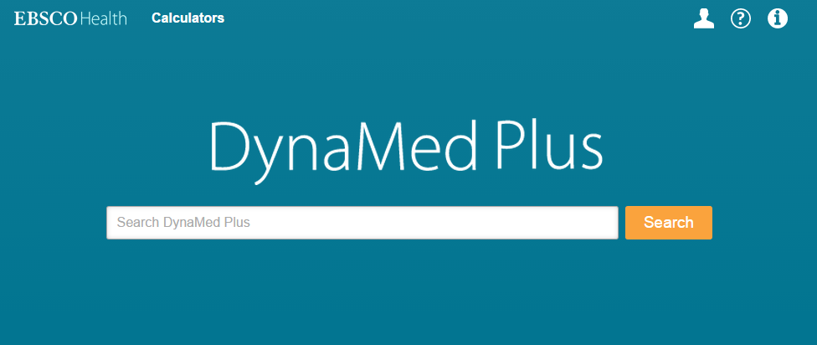
Precise Search Results
Search
employs a brand new, proprietary, semantically-powered search engine, significantly improving discoverability and speed-to-answer
Notes:
There are a number of ways that we’ve solved the problem of accessing content quickly. We’re focusing on the idea of “Time to answer”.
One of the ways we’ve already seen with overviews and recommendations – adding recommendations at the top of a topic decreases the time to answer for the clinician. We’ve also tackled this problem from a technological standpoint.
SEGUE: For instance we saw two different search behaviors: 1) I know what I want so give it to me; 2) I’m not sure what I want…I’m kind of browsing…

Slide 24
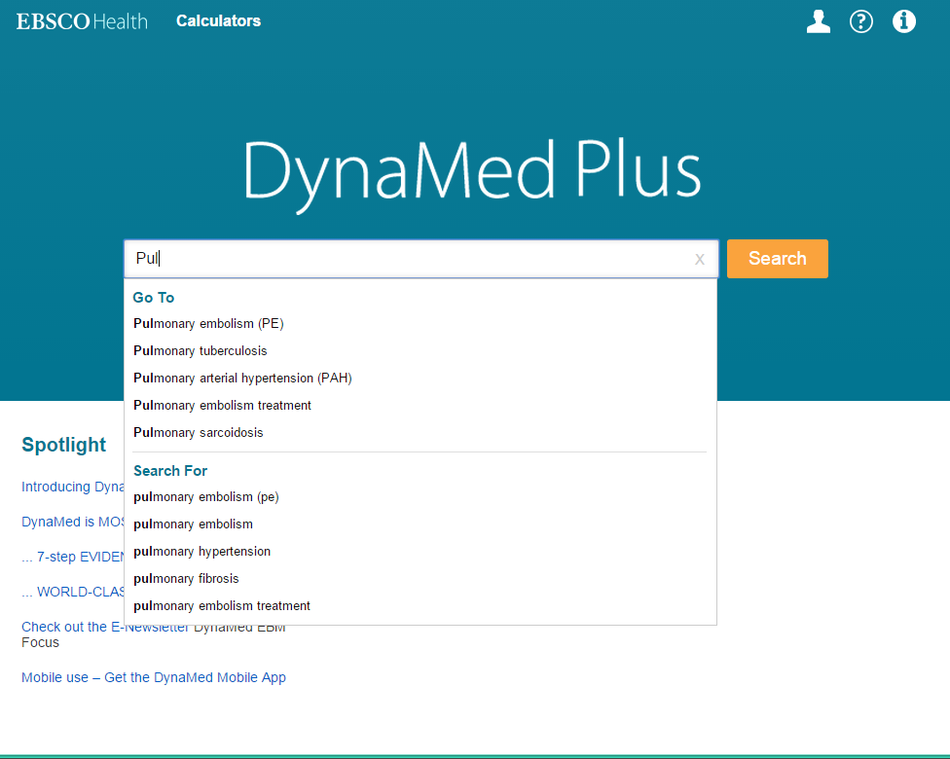
DynaMed+ employs intelligent auto-suggest, which identifies the user’s query and allows direct navigation to highly-accessed areas within topics
Notes:
We’re addressing both of those behaviors in one search box.
We’ve built a knowledge base and now suggest the term after two letters typed. We’ve added ‘go to’ as well as ‘search for’.
SEGUE: the results screen is compiling several like concepts onto the page

Slide 25
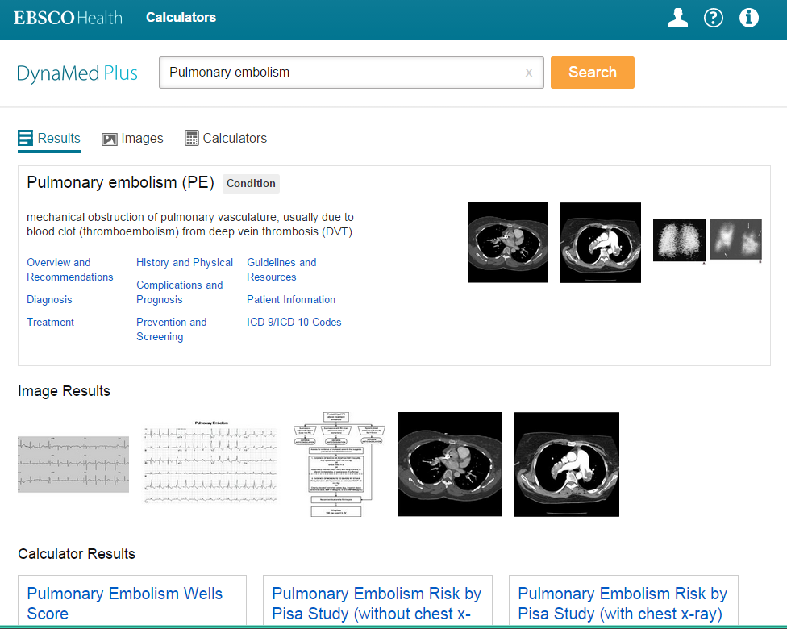
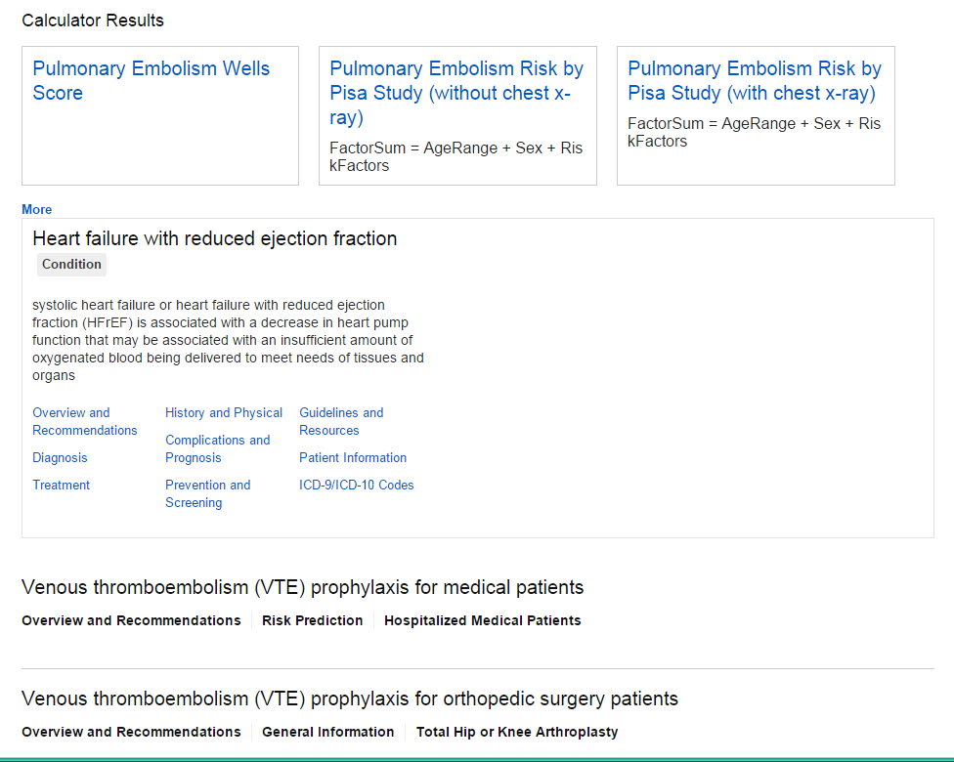
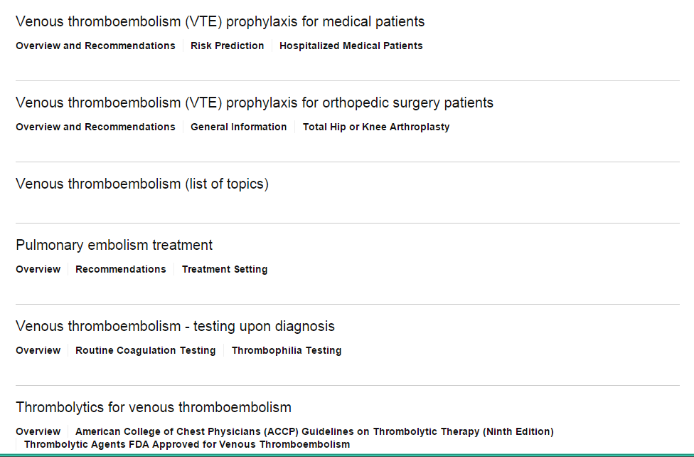
Convenient filters allow quick access to images and calculators that are relevant to the user’s query
DynaMed+ offers superb navigation within the results display
With exact-match queries, DynaMed will display a medical information placard, offering topic-specific links, images, and information.
Notes:
Referencing our Google observations earlier we’re trying to mirror some of the best things about that interface. Like Google, we have categories across the top to quickly filter kinds of content.
When we have a term match, we present the topic-specific links and images.
At this point, the physician has typed two letters and one click. Our studies suggest that this is even faster than Google at this point. Plus the info is much more relevant.

Slide 26
By understanding the user’s intent, DynaMed’s intelligent search is able to identify queries that would yield a large corpus of image results and displays them, in a time-saving image carousel
This same technology allows us to present the user with query-specific calculators
Notes:
Further, DynaMed Plus learns based the click so its accuracy of predicting the right answer continues to go up (just like Google)

Slide 27
Grouped results allow the clinician to quickly understand the context of the result
EXAMPLE: Result shows Pulmonary embolism within the Heart failure with reduced ejection fraction topic, and the path provides the context to understand that the result refers
to treatment medications
Relevant results will navigate users directly to the specific section within DynaMed’s clinically relevant outline-based structure
Notes:
We’re doing a lot to create a first page that anticipates not only the topic searched but related items and that concept in the context of other topics. This is groundbreaking and something that the medical informatics community has been asking about for years.
SEGUE: at the same time, it’s easy to get lost in a topic, especially on a mobile device.

Slide 28
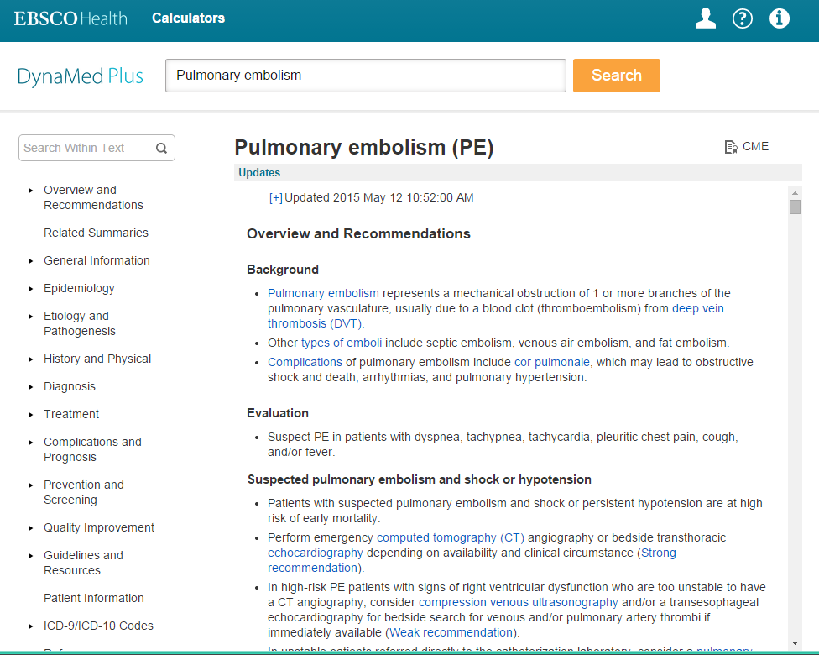
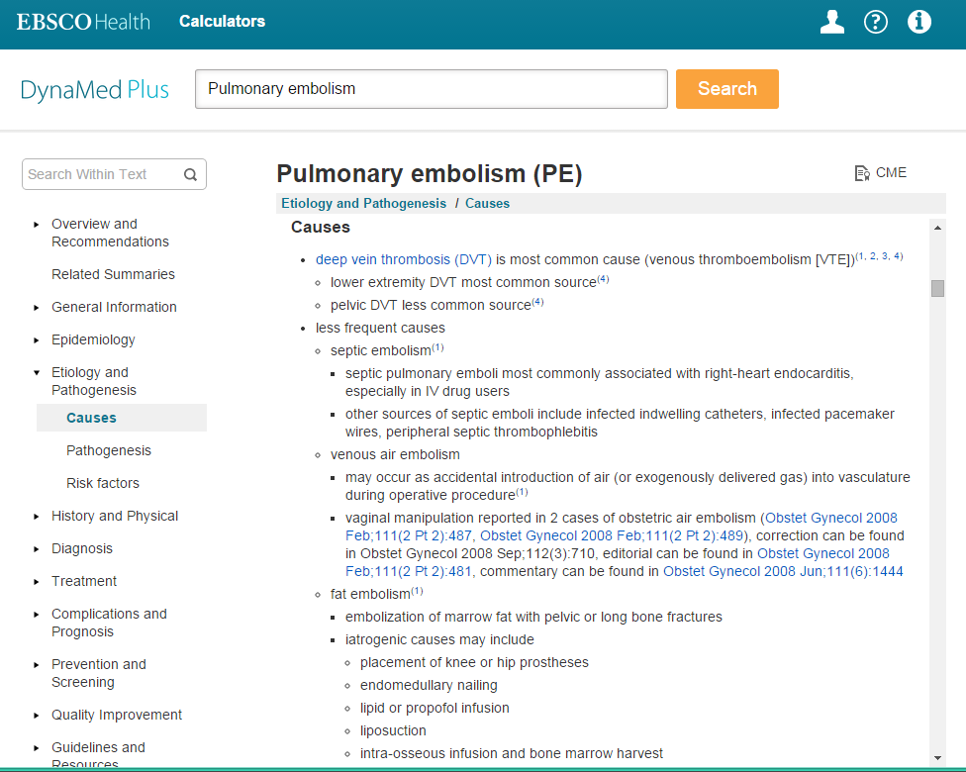
Topic view offers next-generation navigation, providing immediate context to the user
Location within the topic is dynamically updated both in the navigation bar, as well as within the breadcrumb trail at the top of the screen.
Notes:
DM+ has a breadcrumb trail and a dynamic left nav to help with this. You may have noticed this earlier in Afib. As I kept drilling down into the topic, the left nav dynamically rendered to where we were
SEGUE: We’ve kept some of the regular DynaMed features as well

Slide 29
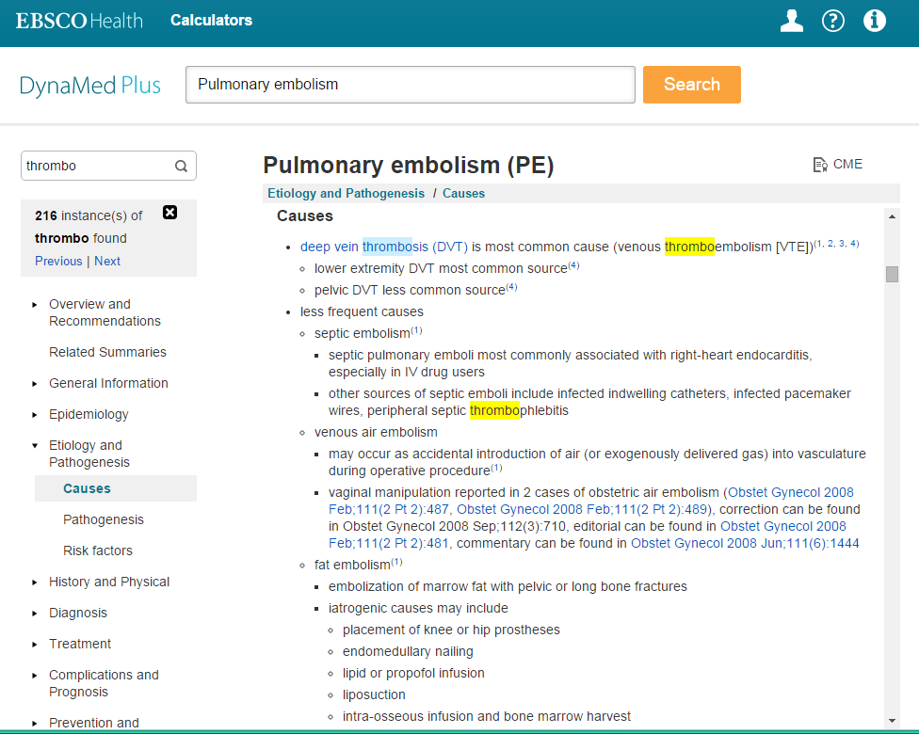
DynaMed+ also offers all of the same quick-access features users have come to expect, including search within and hit highlighting
Notes:
Searching within a topic is easy and efficient
SEGUE: Remember, I started the interface conversation by talking about the two big take aways for information seeking physicians: Google and Mobile

Slide 30
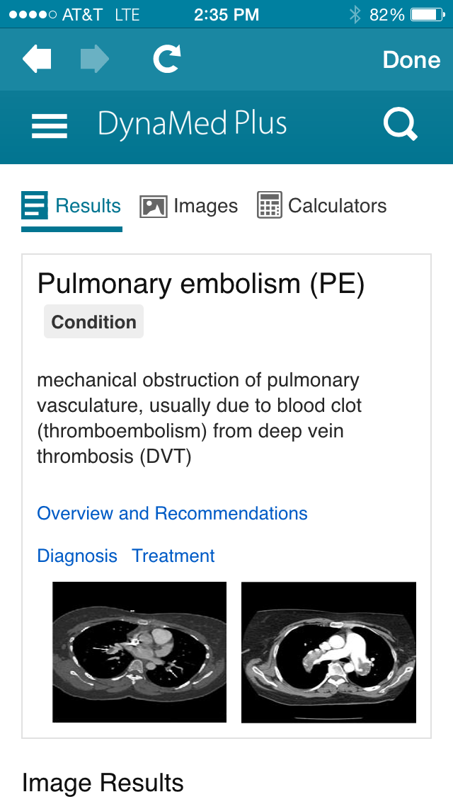
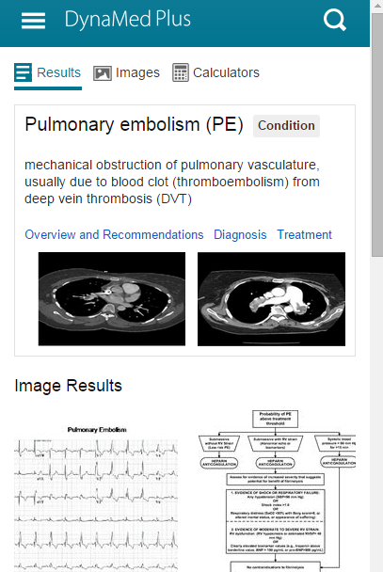
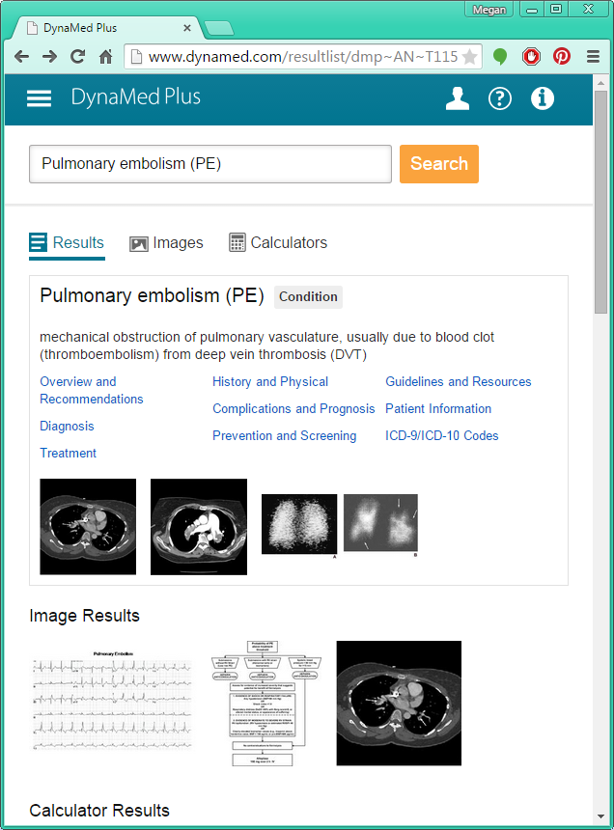
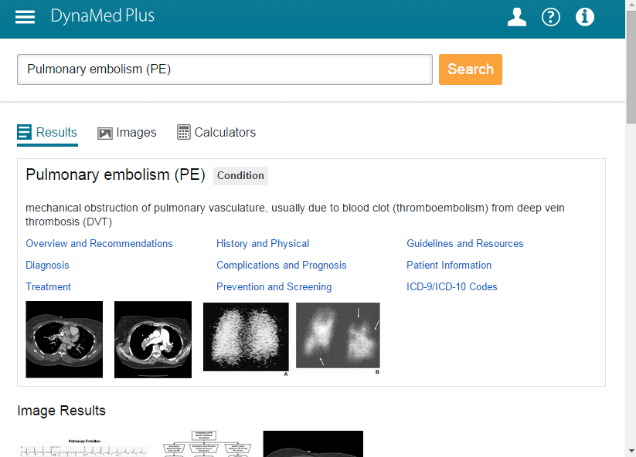
DynaMed Plus employs a
FULLY RESPONSIVE DESIGN, which means it renders ideally for any device or orientation
iPhone
Small Tablet
iPad - Portrait
iPad - Landscape
Notes:
I know we just released a new DynaMed mobile app and it’s a lot better than the last one. Well, DM+ has an even better mobile interface because we’re using responsive design meaning that the system knows the capabilities of your display and dynamically renders the content appropriate for your device.
SEGUE: These views are pretty small

Slide 31
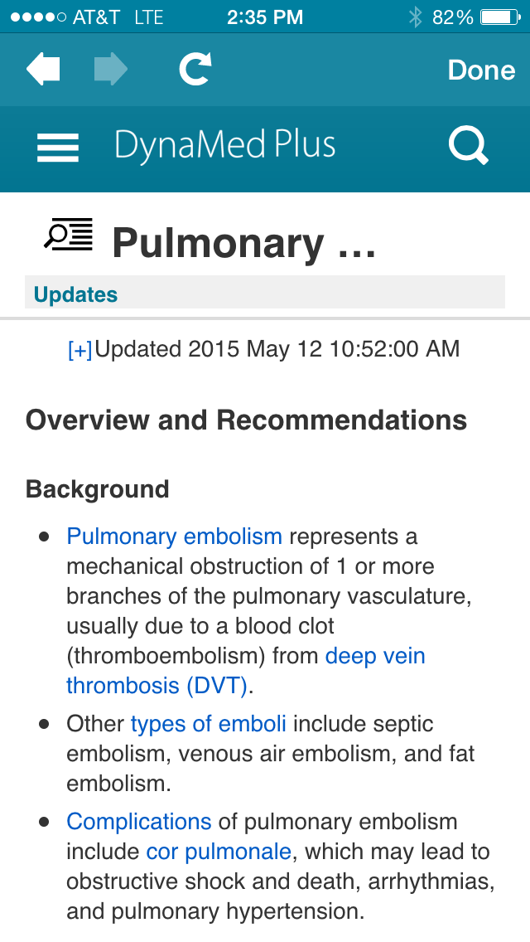
iPhone
Notes:
So let’s look at bigger pictures
This is the smallest device so I get two pics and the topic

Slide 32
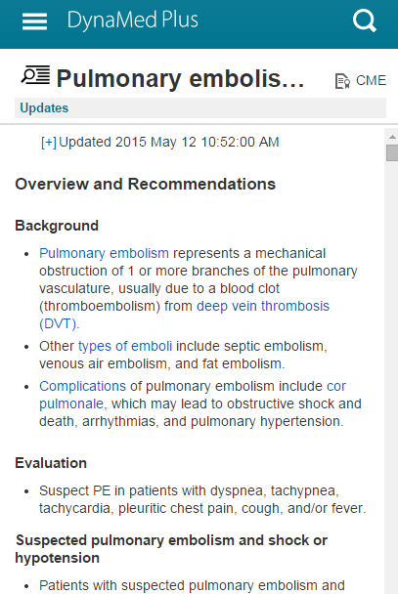
Small Tablet
Notes:
This is like the big Samsung or Iphone so now I get two pics and two diagrams and more of the overview

Slide 33
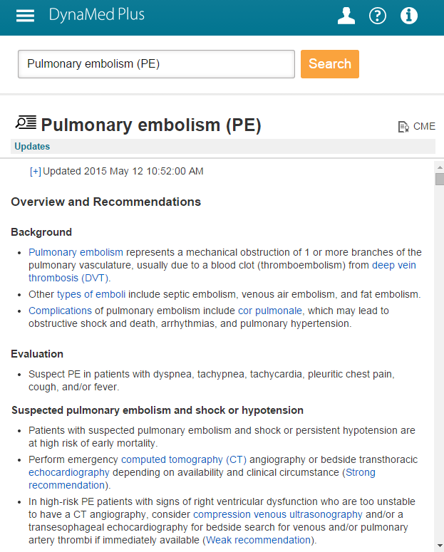
iPad - Portrait
Notes:
And on an ipad or bigger tablet I get more of the topic and links to the calculator as well.

Slide 34
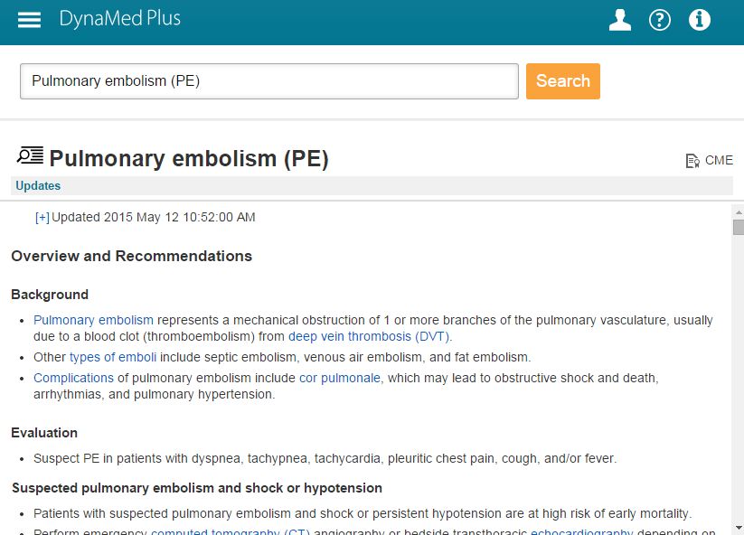
iPad - Landscape
Notes:
All of this means that the answers are easier to find in a way that the physician is looking for them – on their mobile devices. This is the interface of the future and a place where we’re leading the POC industry.
We still have the offline version as well. This is suitable for rural access, disaster planning, and other scenarios where there isn’t a persistent wifi connection. However, the majority of users will access the site directly from their mobile devices without an app.
SEGUE: I’ve just covered the attributes which make us a legitimate replacement for UTD. I also talked about our new search features which make us the industry-leading point of care search tool.

Slide 35

EBSCO Health listens to the needs of our customers
and users which helps us build better products
DynaMed Plus has….
overviews and recommendations
well-known expert reviewers
increased breadth/depth of specialty content
multimedia content
better search & discovery
Notes:
Now I’d like to talk about two exciting partnerships which add to our content and validate that we’re on the right track.
SEGUE: The first is drug content

Slide 36
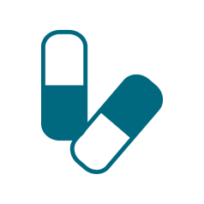
MICROMEDEX DRUG CONTENT
Micromedex evidence-based content is presented in concise, sourced, and referenced blocks of information to help you get answers quickly when the situation demands.
Medication Management Standard Drug Information
Drug Information for Medication Safety
IV Compatibility for Reduced Complications
Lab Recommendations
Notes:
We have a partnership with Micromedx. We’re loading the content from their main four files below. Further, if you have Micromedx we have full two-way integration between the two resources.
It’s interesting to note that Micromedx no longer supports its old point of care product, Diseasedex. Instead they are partnering with DM+ for that capability.
SEGUE: The other partnership is even more exciting which is why I’ve saved it for last. That’s right we’re almost done.

Slide 37

ACP Partnership
ACP clinical leadership develops and maintains DynaMed Plus internal medicine topics
Multiple members of ACP are part of the DynaMed Plus Executive Board.
ACP is integrating its Smart Medicine into DynaMed Plus
All 140,000 members of ACP will
have access to DynaMed Plus
as part of their membership
Notes:
We’re working with the American College of Physicians in several ways:
The ACP is developing and maintaining our Internal Medicine topics in conjunction with the DM+ team. ACP has devoted one of their senior editors to this project.
THE ACP sits on our executive board
ACP’s point of care product, Smart Medicine (formerly ACP PIER) is going away. By the end of the summer the content will be integrated into DM+
All of ACP’s 140K members will have access to DM+ as part of their membership to ACP.
This is a big deal!
SEGUE: In conclusion

Slide 38



SUMMARY OF FEATURES
Graphics & Images
Access thousands of graphics and images
Overviews & Recommendations
Read concise overviews and detailed recommendations
Precise Search Results
Get precise search results every time.
Specialty Content
DynaMed Plus includes robust specialty content.
Expert Reviewers
Deputy Editors are supported by an extensive network of clinical experts.
Mobile App
The mobile app is complimentary with every subscription, at no extra cost.
Drug Content
Drug content to help with diagnosis with Micromedex® Clinical Knowledge Suite
Notes:
In summary…

Slide 39
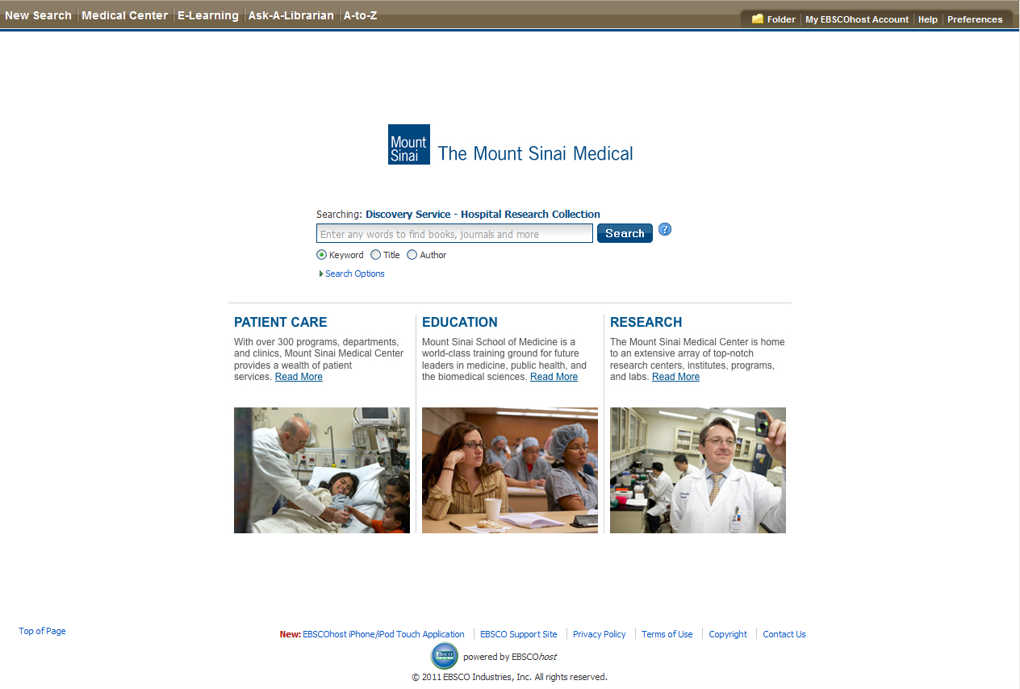
Branded
Notes:
39

Slide 40
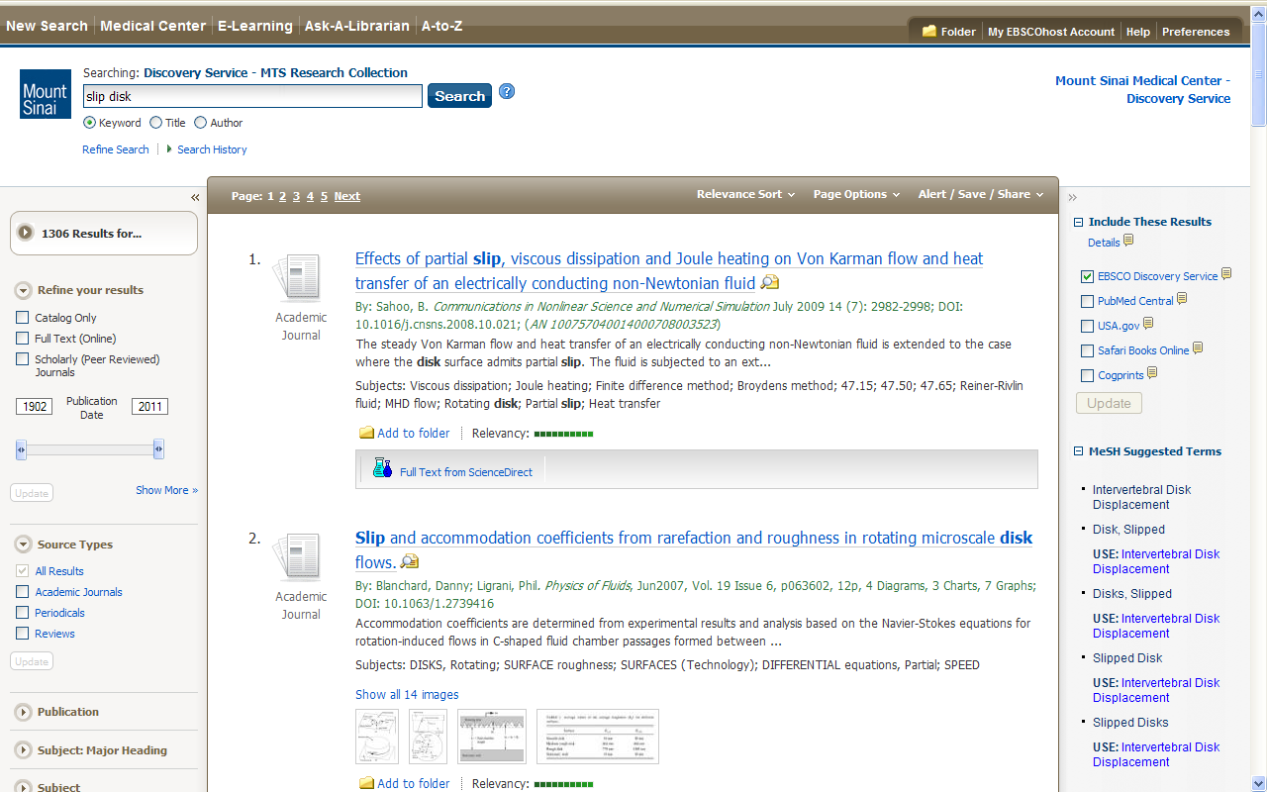
Customizable Widgets
Notes:
40

Slide 41
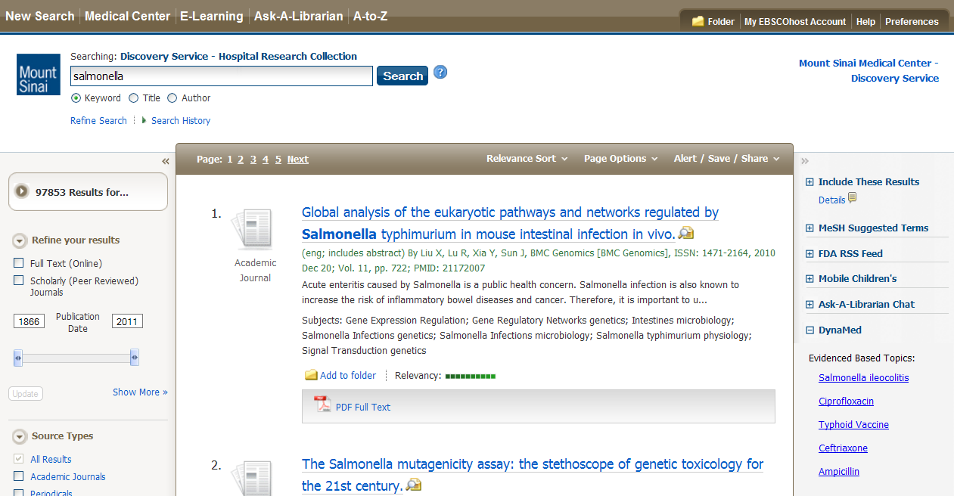
Customizable Widgets
Notes:
41

Slide 42
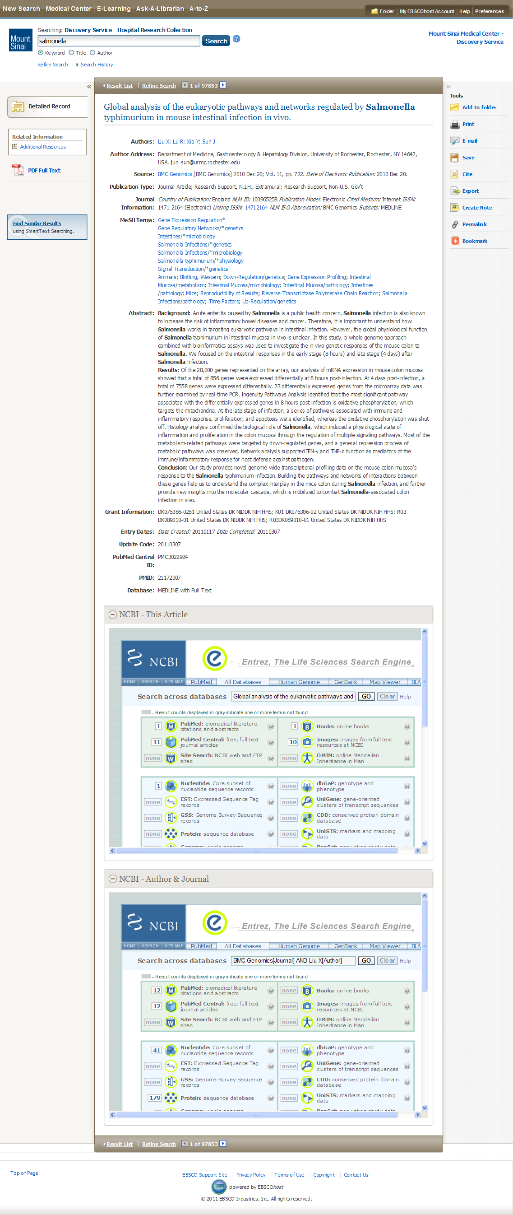
Notes:
42

Slide 43
Subject indexing and thesauri are fully integrated with PubMed’s indexing and MeSH from:
CINAHL | PsycINFO® | Cochrane
And many more

Slide 44
Some Examples
Kaiser
Northbay
Natividad

